Slide 1
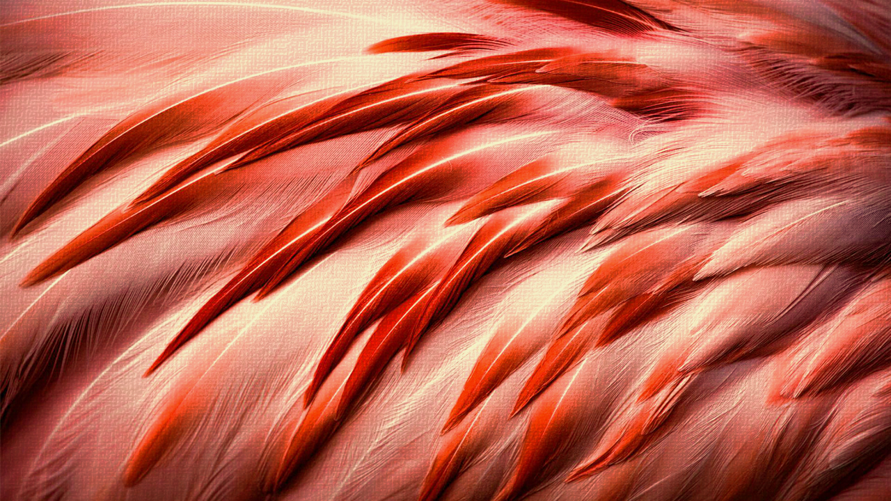

Leaf disease detection & Prediction
MINI PROJECT 5TH SEM
by
AMAN AGNIHOTRI | ANUSHRI TIWARI | AGAM PATEL

Slide 2


OVERVIEW
01 | PROJECT INTRO
02 | PROBLEM STATEMENT
03 | TECHNOLOGIES USED
04 | PROPOSED WORK
05 | MODEL AND FEATURES
06 | SUMMARY & CURRENT PROGRESS

Slide 3
PROJECT INTrOduction
Plant disease detection is critical in agriculture, significantly impacting crop yield and food supply. This paper introduces an innovative approach utilizing deep learning and computer vision techniques to detect and classify plant diseases.
The proposed method involves image processing to analyze leaf health conditions using a dataset of varied leaf images exhibiting disease manifestations.
The model is trained to recognize distinct patterns associated with different diseases, enabling early detection and intervention. This AI-based system aims to enhance agricultural productivity, minimize crop losses, and contribute to food security.
Furthermore, it has potential application in mobile platforms, providing farmers with a user-friendly tool for managing plant diseases.

Slide 4

PROBLEM STATEMENT
LEAF DISEASE DETECTION

Slide 5

Problem statement
The objective of this project is to design and implement an automated system capable of accurately detecting and classifying leaf diseases using deep learning techniques. By leveraging advanced image-based prediction models, this project aims to assist farmers and agricultural stakeholders in identifying plant diseases at an early stage, thereby minimizing crop losses and enhancing agricultural productivity. Additionally, this project seeks to promote the integration of artificial intelligence in agriculture, demonstrating its potential to address real-world challenges in sustainable and efficient farming practices.

Slide 6
Technologies used
LEAF DISEASE DETECTION

Slide 7



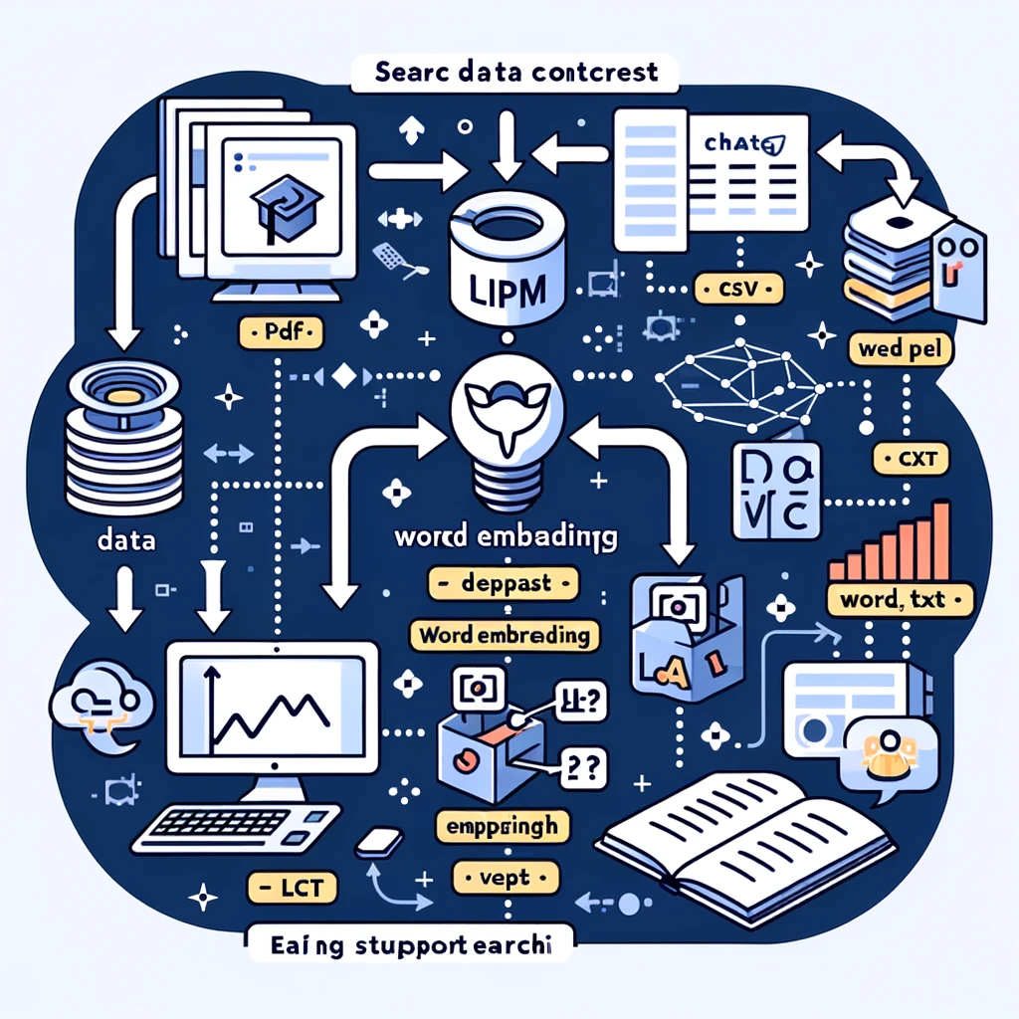




Some new gen amazing tech used
Machine learning
Python
Streamlit
Langchain
Ollama llama 3
Tensorflow-keras
kaggle
Colab notebooks

Slide 8
Proposed work
LEAF DISEASE DETECTION

Slide 9
Proposed work
Image acquisition from datasets or real-time capture using cameras.
Image preprocessing for consistent input to the models.
Training and evaluation of deep learning models (MobileNet, ResNet, etc.).
Deployment of a user-friendly interface using Streamlit for predictions.
Integration of an AI chatbot using Langchain for additional assistance.
Scalability for detecting more diseases and supporting diverse plant species.

Slide 10

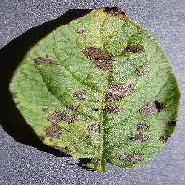
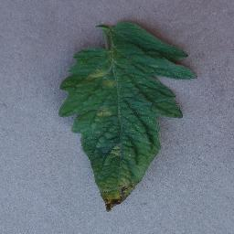
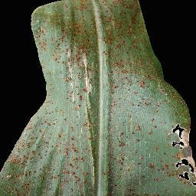
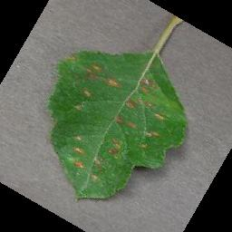
Target classes
There are more than 35 diseases we can already detect!
potato
tomato
corn
apple
There are 3 diseases of potatoes.
There are 10 diseases of tomatoes.
There are 4 diseases of conn.
There are 3 diseases of apple.

Slide 11
MODELs
SOME MODELS USED AND TESTED
4.2 million
RES-NET
63 million
138 million
INCEPTION-NET
MOBILE-NET
DENSE-NET
8-33 Million

Slide 12
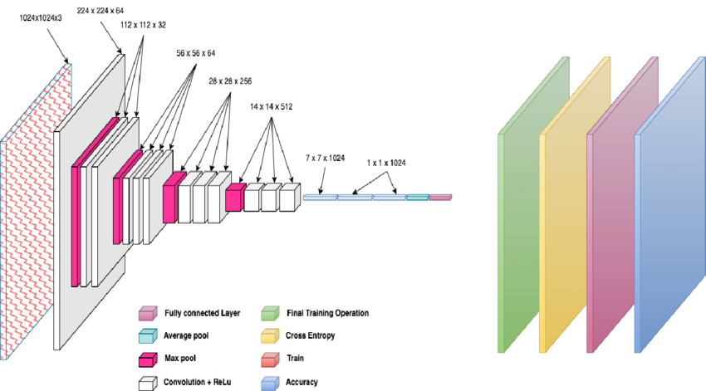
Best model architecture

Slide 13
Working of project
LEAF DISEASE DETECTION

Slide 14

Prediction pipeline
INPUT IMAGE
IMAGE PRE-PROCESSING
CNN MODEL
PREDICTION
OUTPUT
THE USER WILL EITHER UPLOAD OR TAKE THE IMAGE FROM THE CAMERA.
THE IMAGE WILL BE PREPROCESSED ACCORDING TO THE MODEL REQUIREMENTS.
THE CNN MODEL WILL WORK ON THE IMAGE AND CREATE FETURE MAPS ETC.
THE FINAL OUTPUT FROM THE MODEL AS THE CLASS WHICH THE IMAGE BELONGS.
THE FINAL OUTPUT ON THE SCREEN WITH THE DISEASE DETECTED AND ITS REMEDIES.

Slide 15
SOME OTHER FEATURES IN THE PROJECT
DISEASE PREVENTIVE SUGGESTION
TUTORIALS AND DOCS
THE PROJECT NOT ONLY DETECT THE DISEASE BUT ALSO SUGGESTS THE PREVENTIVE METHODS.
A DEDICATED INTERFACE FOR TUTORIALS, MODEL INFO, PLATFORM INFO WILL BE THERE.
MULTI MODEL
HELPING CHATBOT
THE PROJECT WILL PROVIDE FACILITY OF DIFFERENT MODELS AND MAYBE HYBRID MODEL SELECTION.
AN AI CHATBOT WILL BE USED TO HELP USERS REGARDING OUR PLATFORM AND ANY QUERY RELATED TO THE DISEASES.

Slide 16
SUMMARY
LEAF DISEASE DETECTION

Slide 17


“THE PROJECT WILL BE OVERALL HELPFUL IN DETECTING THE LEAF/PLANT DISEASES WITH HIGH ACCURACY AND PROVIDING FURTHER GUIDANCE.”
SUMMARY

Slide 18
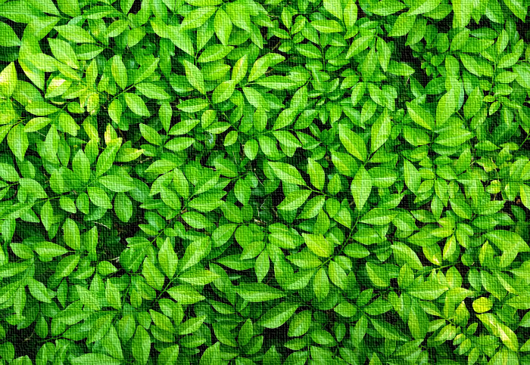
CURRENT PROGRESS
The Project is working!

Slide 19

THANK
Leaf disease detection & Prediction
AGAM PATEL
(0205CC221015)
ANUSHRI TIWARI
(0205CC221030)
AMAN AGNIHOTRI
(0205CC221019)
You!

